Slide 1
What’s in Your Innovation Backbone™? Innovation Business Partners Inc.
Dr. Morton Tavel
Mike Jensen
Gary Markovits
Devin Markovits
Blake Markovits

Slide 2
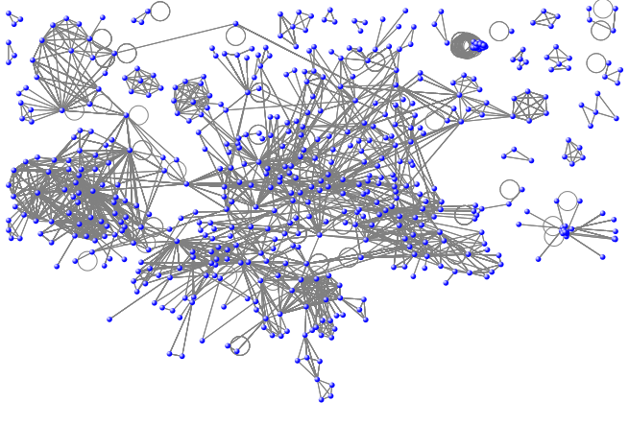
Actual Innovation Network

Slide 3
Betweenness Centrality Scaled 0-100

Slide 4
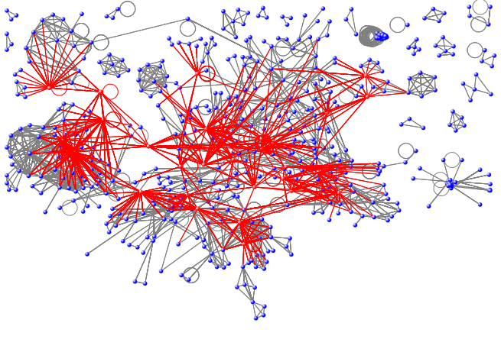
The Innovation Background™ (shown in red)

Slide 5
Thank you! Morton Tavel mort@innovationbp.com
Questions?

